Slide 1


CSB4403 – Applied Cryptography and Network Security
B.Tech – VII Semester
Dr. S.Sathya Priya
Associate professor
School of Computing Sciences,
Department of Computer Science and Engineering

Slide 2
MODULE 3: AUTHENTICATION AND HASH FUNCTION
RSA Algorithm, Diffie-Hellman Key Exchange Algorithm, Applications of Cryptographic Hash Functions, Message Authentication Code- Requirements-Functions- Security, MACs Based on Hash Functions (HMAC), MACs Based on Block Ciphers- Data Authentication Algorithm (DAA) – Cipher-based Message Authentication Code(CMAC) , Digital Signatures –Properties - Attacks and Forgeries - Requirements - Direct Digital Signature, Digital Signature Standard

Slide 3
Misconceptions Concerning Public-Key Encryption
Public-key encryption is more secure from cryptanalysis than symmetric encryption
Public-key encryption is a general-purpose technique that has made symmetric encryption obsolete
There is a feeling that key distribution is trivial when using public-key encryption, compared to the cumbersome handshaking involved with key distribution centers for symmetric encryption

Slide 4
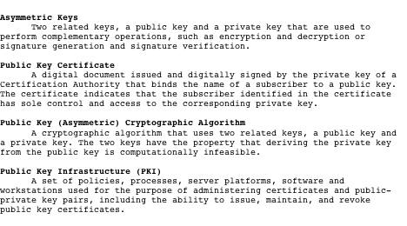
Terminology Related to Asymmetric Encryption

Slide 5
Principles of Public-Key Cryptosystems
The concept of public-key cryptography evolved from an attempt to attack two of the most difficult problems associated with symmetric encryption:
Whitfield Diffie and Martin Hellman from Stanford University achieved a breakthrough in 1976 by coming up with a method that addressed both problems and was radically different from all previous approaches to cryptography
Key distribution
How to have secure communications in general without having to trust a KDC with your key
Digital signatures
How to verify that a message comes intact from the claimed sender
Notes:
The concept of public-key cryptography evolved from an attempt to attack two of
the most difficult problems associated with symmetric encryption. The first problem
is that of key distribution, which is examined in some detail in Chapter 14.
As Chapter 14 discusses, key distribution under symmetric encryption requires
either (1) that two communicants already share a key, which somehow has been distributed
to them; or (2) the use of a key distribution center. Whitfield Diffie, one
of the discoverers of public-key encryption (along with Martin Hellman, both at
Stanford University at the time), reasoned that this second requirement negated
the very essence of cryptography: the ability to maintain total secrecy over your
own communication. As Diffie put it [DIFF88], “what good would it do after all to
develop impenetrable cryptosystems, if their users were forced to share their keys
with a KDC that could be compromised by either burglary or subpoena?”
The second problem that Diffie pondered, and one that was apparently
unrelated to the first, was that of digital signatures . If the use of cryptography
was to become widespread, not just in military situations but for commercial and
private purposes, then electronic messages and documents would need the equivalent
of signatures used in paper documents. That is, could a method be devised
that would stipulate, to the satisfaction of all parties, that a digital message had
been sent by a particular person? This is a somewhat broader requirement than
that of authentication, and its characteristics and ramifications are explored in
Chapter 13.
Diffie and Hellman achieved an astounding breakthrough in 1976
[DIFF76 a, b] by coming up with a method that addressed both problems and was
radically different from all previous approaches to cryptography, going back over
four millennia.

Slide 6
Public-Key Cryptosystems
A public-key encryption scheme has six ingredients:
Plaintext
The readable message or data that is fed into the algorithm as input
Encryption algorithm
Performs various transform-ations on the plaintext
Public key
Used for encryption or decryption
Private key
Used for encryption or decryption
Ciphertext
The scrambled message produced as output
Decryption algorithm
Accepts the ciphertext and the matching key and produces the original plaintext
Notes:
Asymmetric algorithms rely on one key for encryption and a different but related
key for decryption. These algorithms have the following important characteristic.
• It is computationally infeasible to determine the decryption key given only
knowledge of the cryptographic algorithm and the encryption key.
In addition, some algorithms, such as RSA, also exhibit the following characteristic.
• Either of the two related keys can be used for encryption, with the other used
for decryption.
A public-key encryption scheme has six ingredients (Figure 9.1a; compare
with Figure 2.1).
• Plaintext: This is the readable message or data that is fed into the algorithm as
input.
• Encryption algorithm: The encryption algorithm performs various transformations
on the plaintext.
• Public and private keys: This is a pair of keys that have been selected so that
if one is used for encryption, the other is used for decryption. The exact transformations
performed by the algorithm depend on the public or private key
that is provided as input.
• Ciphertext: This is the scrambled message produced as output. It depends on
the plaintext and the key. For a given message, two different keys will produce
two different ciphertexts.
• Decryption algorithm: This algorithm accepts the ciphertext and the matching
key and produces the original plaintext.

Slide 7
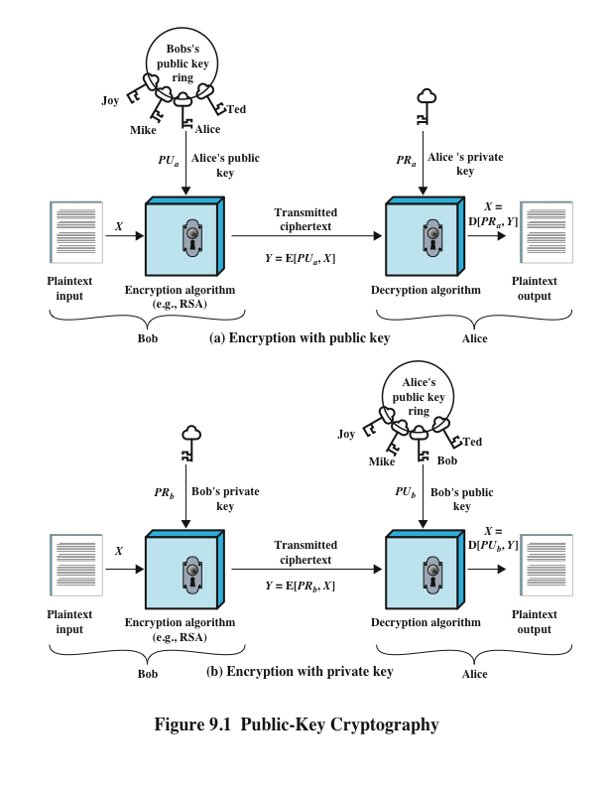

Slide 8
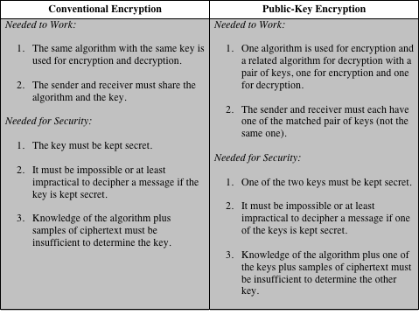
Table 9.2 Conventional and Public-Key Encryption
Notes:
Table 9.2 summarizes some of the important aspects of symmetric and public-key
encryption. To discriminate between the two, we refer to the key used in symmetric
encryption as a secret key . The two keys used for asymmetric encryption are
referred to as the public key and the private key . Invariably, the private key is kept
secret, but it is referred to as a private key rather than a secret key to avoid confusion
with symmetric encryption.

Slide 9
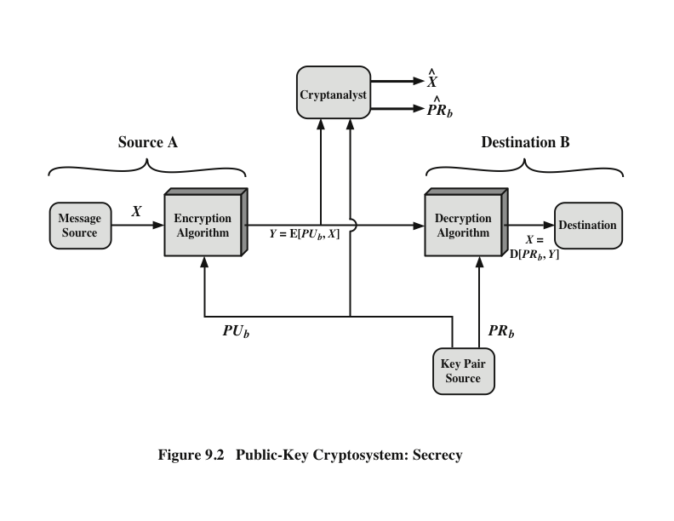
Public-Key Cryptosystem: Secrecy
Notes:
Let us take a closer look at the essential elements of a public-key encryption
scheme, using Figure 9.2 (compare with Figure 2.2).

Slide 10
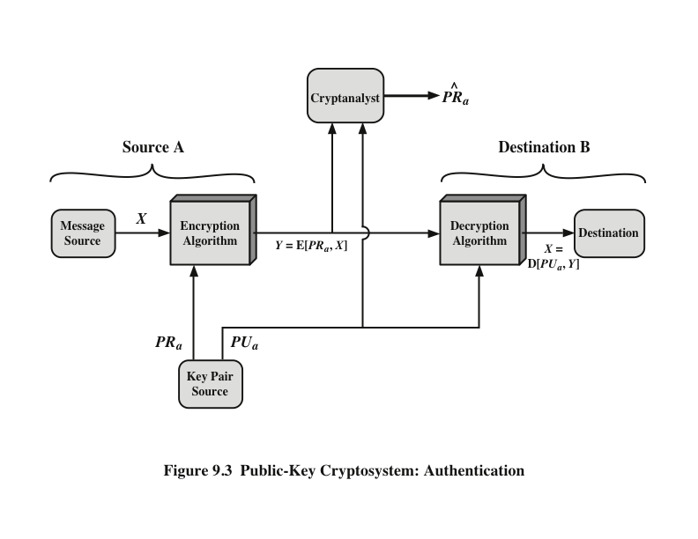
Public-Key Cryptosystem: Authentication
Notes:
We mentioned earlier that either of the two related keys can be used for encryption,
with the other being used for decryption. This enables a rather different
cryptographic scheme to be implemented. Whereas the scheme illustrated in
Figure 9.2 provides confidentiality, Figures 9.1b and 9.3 show the use of public-key
encryption to provide authentication.
It is important to emphasize that the encryption process depicted in
Figures 9.1b and 9.3 does not provide confidentiality. That is, the message being
sent is safe from alteration but not from eavesdropping. This is obvious in the
case of a signature based on a portion of the message, because the rest of the
message is transmitted in the clear. Even in the case of complete encryption,
as shown in Figure 9.3, there is no protection of confidentiality because any
observer can decrypt the message by using the sender’s public key.

Slide 11

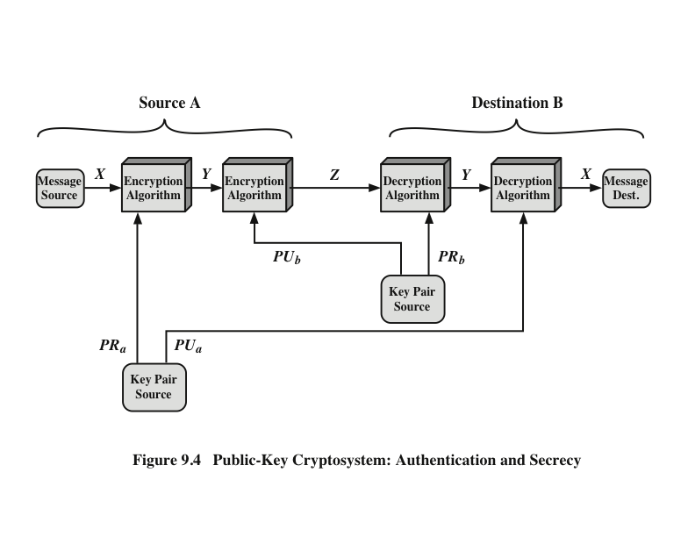
Public-Key Cryptosystem: Authentication and Secrecy
Notes:
It is, however, possible to provide both the authentication function and confidentiality
by a double use of the public-key scheme (Figure 9.4).
In this case, we begin as before by encrypting a message, using the sender’s private
key. This provides the digital signature. Next, we encrypt again, using the receiver’s
public key. The final ciphertext can be decrypted only by the intended receiver, who
alone has the matching private key. Thus, confidentiality is provided. The disadvantage
of this approach is that the public-key algorithm, which is complex, must be
exercised four times rather than two in each communication.

Slide 12
Applications for Public-Key Cryptosystems
Public-key cryptosystems can be classified into three categories:
Some algorithms are suitable for all three applications, whereas others can be used only for one or two
Encryption/decryption
The sender encrypts a message with the recipient’s public key
Digital signature
The sender “signs” a message with its private key
Key exchange
Two sides cooperate to exchange a session key
Notes:
Before proceeding, we need to clarify one aspect of public-key cryptosystems that is
otherwise likely to lead to confusion. Public-key systems are characterized by the use
of a cryptographic algorithm with two keys, one held private and one available publicly.
Depending on the application, the sender uses either the sender’s private key or
the receiver’s public key, or both, to perform some type of cryptographic function. In
broad terms, we can classify the use of public-key cryptosystems into three categories
• Encryption/decryption: The sender encrypts a message with the recipient’s
public key.
• Digital signature: The sender “signs” a message with its private key. Signing
is achieved by a cryptographic algorithm applied to the message or to a small
block of data that is a function of the message.
• Key exchange: Two sides cooperate to exchange a session key. Several different
approaches are possible, involving the private key(s) of one or both parties.

Slide 13
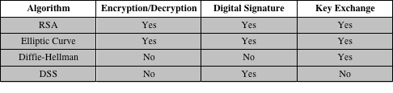
Applications for Public-Key Cryptosystems

Slide 14



Public-Key Requirements
Conditions that these algorithms must fulfill:
It is computationally easy for a party B to generate a pair (public-key PU_{b}, private key PR_{b})
It is computationally easy for a sender A, knowing the public key and the message to be encrypted, to generate the corresponding ciphertext
It is computationally easy for the receiver B to decrypt the resulting ciphertext using the private key to recover the original message
It is computationally infeasible for an adversary, knowing the public key, to determine the private key
It is computationally infeasible for an adversary, knowing the public key and a ciphertext, to recover the original message
The two keys can be applied in either order

Slide 15
Public-Key Requirements
Need a trap-door one-way function
A one-way function is one that maps a domain into a range such that every function value has a unique inverse, with the condition that the calculation of the function is easy, whereas the calculation of the inverse is infeasible
Y = f(X) easy
X = f^{–1}(Y) infeasible
A trap-door one-way function is a family of invertible functions f_{k}, such that
Y = f_{k}(X) easy, if k and X are known
X = f_{k}^{–1}(Y) easy, if k and Y are known
X = f_{k}^{–1}(Y) infeasible, if Y known but k not known
A practical public-key scheme depends on a suitable trap-door one-way function
Notes:
Before elaborating on why the requirements are so formidable, let us first recast
them. The requirements boil down to the need for a trap-door one-way function.
A one-way function is one that maps a domain into a range such that every
function value has a unique inverse, with the condition that the calculation of the
function is easy, whereas the calculation of the inverse is infeasible
Y = f(X) easy
X = f^{–1}(Y) infeasible
Generally, easy is defined to mean a problem that can be solved in polynomial
time as a function of input length. Thus, if the length of the input is n bits, then the
time to compute the function is proportional to nª , where a is a fixed constant. Such
algorithms are said to belong to the class P . The term infeasible is a much fuzzier
concept. In general, we can say a problem is infeasible if the effort to solve it grows
faster than polynomial time as a function of input size. For example, if the length
of the input is n bits and the time to compute the function is proportional to 2^{n} ,
the problem is considered infeasible. Unfortunately, it is difficult to determine if a
particular algorithm exhibits this complexity. Furthermore, traditional notions of
computational complexity focus on the worst-case or average-case complexity of
an algorithm. These measures are inadequate for cryptography, which requires that
it be infeasible to invert a function for virtually all inputs, not for the worst case or
even average case. A brief introduction to some of these concepts is provided in
Appendix 9A.
We now turn to the definition of a trap-door one-way function , which is easy
to calculate in one direction and infeasible to calculate in the other direction unless
certain additional information is known. With the additional information the
inverse can be calculated in polynomial time. We can summarize as follows: A trapdoor
one-way function is a family of invertible functions f_{k} , such that
Y = f_{k}(X) easy, if k and X are known
X = f_{k}^{–1}(Y) easy, if k and Y are known
X = f_{k}^{–1}(Y) infeasible, if Y known but k not known
Thus, the development of a practical public-key scheme depends on discovery of a suitable trap-door one-way function.

Slide 16
Public-Key Cryptanalysis
A public-key encryption scheme is vulnerable to a brute-force attack
Countermeasure: use large keys
Key size must be small enough for practical encryption and decryption
Key sizes that have been proposed result in encryption/decryption speeds that are too slow for general-purpose use
Public-key encryption is currently confined to key management and signature applications
Another form of attack is to find some way to compute the private key given the public key
To date it has not been mathematically proven that this form of attack is infeasible for a particular public-key algorithm
Finally, there is a probable-message attack
This attack can be thwarted by appending some random bits to simple messages
Notes:
As with symmetric encryption, a public-key encryption scheme is vulnerable to a
brute-force attack. The countermeasure is the same: Use large keys. However, there
is a tradeoff to be considered. Public-key systems depend on the use of some sort of
invertible mathematical function. The complexity of calculating these functions may
not scale linearly with the number of bits in the key but grow more rapidly than that.
Thus, the key size must be large enough to make brute-force attack impractical but
small enough for practical encryption and decryption. In practice, the key sizes that
have been proposed do make brute-force attack impractical but result in encryption/
decryption speeds that are too slow for general-purpose use. Instead, as was mentioned
earlier, public-key encryption is currently confined to key management and
signature applications.
Another form of attack is to find some way to compute the private key given
the public key. To date, it has not been mathematically proven that this form of attack
is infeasible for a particular public-key algorithm. Thus, any given algorithm,
including the widely used RSA algorithm, is suspect. The history of cryptanalysis
shows that a problem that seems insoluble from one perspective can be found to
have a solution if looked at in an entirely different way.
Finally, there is a form of attack that is peculiar to public-key systems. This is,
in essence, a probable-message attack. Suppose, for example, that a message were to
be sent that consisted solely of a 56-bit DES key. An adversary could encrypt all possible
56-bit DES keys using the public key and could discover the encrypted key by
matching the transmitted ciphertext. Thus, no matter how large the key size of the
public-key scheme, the attack is reduced to a brute-force attack on a 56-bit key. This
attack can be thwarted by appending some random bits to such simple messages.

Slide 17
Rivest-Shamir-Adleman (RSA) Scheme
Developed in 1977 at MIT by Ron Rivest, Adi Shamir & Len Adleman
Most widely used general-purpose approach to public-key encryption
Is a cipher in which the plaintext and ciphertext are integers between 0 and n – 1 for some n
A typical size for n is 1024 bits, or 309 decimal digits
Notes:
The pioneering paper by Diffie and Hellman [DIFF76b] introduced a new approach
to cryptography and, in effect, challenged cryptologists to come up with a cryptographic
algorithm that met the requirements for public-key systems. A number of
algorithms have been proposed for public-key cryptography. Some of these, though
initially promising, turned out to be breakable.
One of the first successful responses to the challenge was developed in 1977
by Ron Rivest, Adi Shamir, and Len Adleman at MIT and first published in 1978
[RIVE78]. The Rivest-Shamir-Adleman (RSA) scheme has since that time reigned
supreme as the most widely accepted and implemented general-purpose approach
to public-key encryption.
The RSA scheme is a cipher in which the plaintext and ciphertext are integers
between 0 and n - 1 for some n . A typical size for n is 1024 bits, or 309 decimal
digits. That is, n is less than 2¹⁰²⁴ . We examine RSA in this section in some detail,
beginning with an explanation of the algorithm. Then we examine some of the computational
and cryptanalytical implications of RSA.

Slide 18
RSA Algorithm
RSA makes use of an expression with exponentials
Plaintext is encrypted in blocks with each block having a binary value less than some number n
log2(n)+1
Encryption and decryption are of the following form, for some plaintext block M and ciphertext block C
C = Me mod n
M = C^{d} mod n = (Me)^{d} mod n = M^{ed} mod n
Both sender and receiver must know the value of n
The sender knows the value of e, and only the receiver knows the value of d
This is a public-key encryption algorithm with a public key of PU={e,n} and a private key of PR={d,n}
Notes:
RSA makes use of an expression with exponentials. Plaintext is encrypted in blocks,
with each block having a binary value less than some number n . That is, the block
size must be less than or equal to log₂ (n ) + 1; in practice, the block size is i bits,
where 2^{i} < n ≤ 2^{i+1} . Encryption and decryption are of the following form, for some
plaintext block M and ciphertext block C.
C = Me mod n
M = C^{d} mod n = (Me )^{d} mod n = M^{ed} mod n
Both sender and receiver must know the value of n . The sender knows the
value of e , and only the receiver knows the value of d . Thus, this is a public-key encryption
algorithm with a public key of PU = {e , n } and a private key of PR = {d , n }.

Slide 19
Algorithm Requirements
For this algorithm to be satisfactory for public-key encryption, the following requirements must be met:
1. It is possible to find values of e, d, n such that M^{ed} mod n = M for all M < n
2. It is relatively easy to calculate Me mod n and C^{d} mod n for all values of M < n
3. It is infeasible to determine d given e and n
Notes:
We discuss timing attacks in more detail in Part Two, as they relate to public-key
algorithms. However, the issue may also be relevant for symmetric ciphers. In essence,
a timing attack is one in which information about the key or the plaintext is obtained
by observing how long it takes a given implementation to perform decryptions on
various ciphertexts. A timing attack exploits the fact that an encryption or decryption
algorithm often takes slightly different amounts of time on different inputs. [HEVI99]
reports on an approach that yields the Hamming weight (number of bits equal to one)
of the secret key. This is a long way from knowing the actual key, but it is an intriguing
first step. The authors conclude that DES appears to be fairly resistant to a successful
timing attack but suggest some avenues to explore. Although this is an interesting line
of attack, it so far appears unlikely that this technique will ever be successful against
DES or more powerful symmetric ciphers such as triple DES and AES.

Slide 20
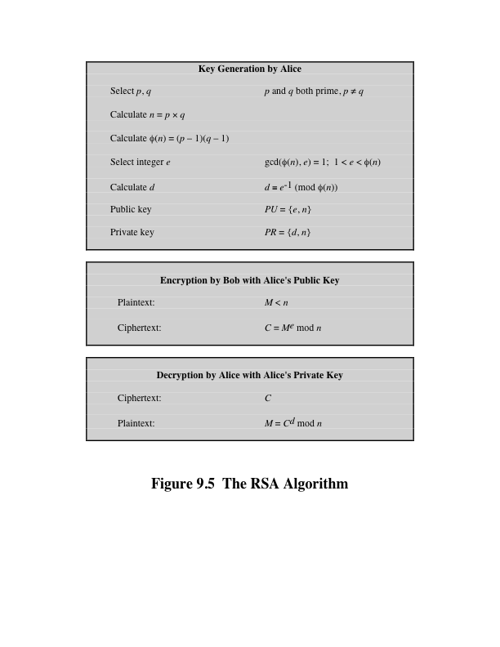
Notes:
Figure 9.5 summarizes the RSA algorithm. It corresponds to Figure 9.1a: Alice
generates a public/private key pair; Bob encrypts using Alice’s public key; and Alice
decrypts using her private key.

Slide 21
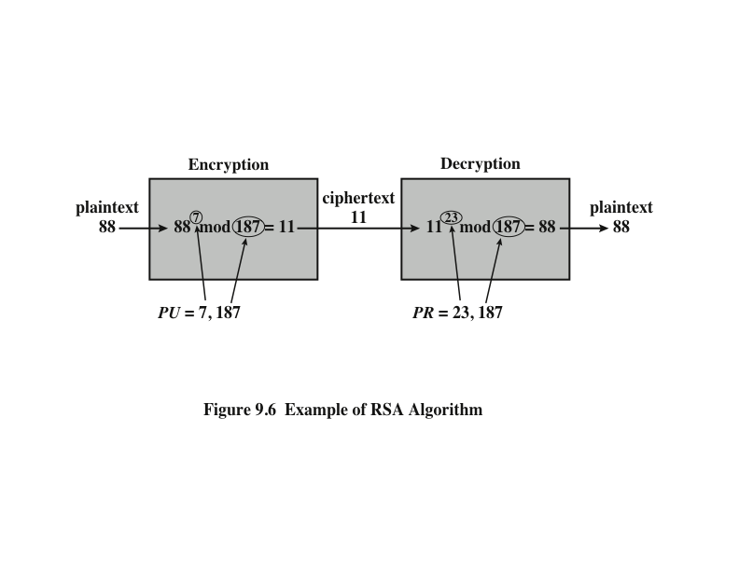
Example of RSA Algorithm
Notes:
An example from [SING99] is shown in Figure 9.6.

Slide 22
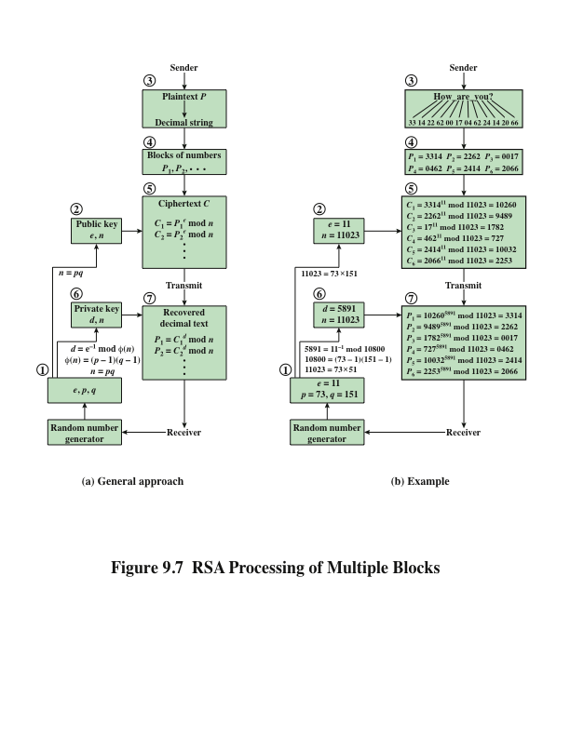
Notes:
Figure 9.7a illustrates the sequence of events for the
encryption of multiple blocks, and Figure 9.7b gives a specific example. The circled
numbers indicate the order in which operations are performed.

Slide 23
Efficient Operation Using the Public Key
To speed up the operation of the RSA algorithm using the public key, a specific choice of e is usually made
The most common choice is 65537 (2¹⁶ + 1)
Two other popular choices are e=3 and e=17
Each of these choices has only two 1 bits, so the number of multiplications required to perform exponentiation is minimized
With a very small public key, such as e = 3, RSA becomes vulnerable to a simple attack
Notes:
To speed up the operation of the RSA algorithm using the public key, can choose to use a small value of e. The most common choice is 65537 (2¹⁶ + 1); two other popular choices are 3 and 17. Each of these choices has only two 1 bits and so the number of multiplications required to perform exponentiation is minimized.
However, with a very small public key, such as e = 3, RSA becomes vulnerable to a simple attack.

Slide 24
Efficient Operation Using the Private Key
Decryption uses exponentiation to power d
A small value of d is vulnerable to a brute-force attack and to other forms of cryptanalysis
Can use the Chinese Remainder Theorem (CRT) to speed up computation
The quantities d mod (p – 1) and d mod (q – 1) can be precalculated
End result is that the calculation is approximately four times as fast as evaluating M = C^{d} mod n directly
Notes:
We cannot similarly choose a small constant value of d for efficient operation. A small value of d is vulnerable to a brute-force attack and to other forms of cryptanalysis [WIEN90]. However, there is a way to speed up computation using the Chinese Remainder Theorem (CRT).
The quantities d mod (p - 1) and d mod (q - 1) can be precalculated. The end
result is that the calculation is approximately four times as fast as evaluating M = C^{d}
mod n directly [BONE02].

Slide 25
Key Generation
Before the application of the public-key cryptosystem each participant must generate a pair of keys:
Determine two prime numbers p and q
Select either e or d and calculate the other
Because the value of n = pq will be known to any potential adversary, primes must be chosen from a sufficiently large set
The method used for finding large primes must be reasonably efficient
Notes:
Before the application of the public-key cryptosystem, each
participant must generate a pair of keys. This involves the following tasks.
• Determining two prime numbers, p and q.
• Selecting either e or d and calculating the other.
First, consider the selection of p and q . Because the value of n = pq will be
known to any potential adversary, in order to prevent the discovery of p and q by
exhaustive methods, these primes must be chosen from a sufficiently large set (i.e.,
p and q must be large numbers). On the other hand, the method used for finding
large primes must be reasonably efficient.
At present, there are no useful techniques that yield arbitrarily large primes,
so some other means of tackling the problem is needed. The procedure that is generally
used is to pick at random an odd number of the desired order of magnitude
and test whether that number is prime. If not, pick successive random numbers until
one is found that tests prime.
A variety of tests for primality have been developed (e.g., see [KNUT98] for
a description of a number of such tests). Almost invariably, the tests are probabilistic.
That is, the test will merely determine that a given integer is probably prime.
Despite this lack of certainty, these tests can be run in such a way as to make the
probability as close to 1.0 as desired. As an example, one of the more efficient
and popular algorithms, the Miller-Rabin algorithm, is described in Chapter 8.
With this algorithm and most such algorithms, the procedure for testing whether
a given integer n is prime is to perform some calculation that involves n and a
randomly chosen integer a . If n “fails” the test, then n is not prime. If n “passes”
the test, then n may be prime or nonprime. If n passes many such tests with many
different randomly chosen values for a , then we can have high confidence that n
is, in fact, prime.

Slide 26
Procedure for Picking a Prime Number
Pick an odd integer n at random
Pick an integer a < n at random
Perform the probabilistic primality test with a as a parameter. If n fails the test, reject the value n and go to step 1
If n has passed a sufficient number of tests, accept n; otherwise, go to step 2
Notes:
In summary, the procedure for picking a prime number is as follows.
1. Pick an odd integer n at random (e.g., using a pseudorandom number
generator).
2. Pick an integer a < n at random.
3. Perform the probabilistic primality test, such as Miller-Rabin, with a as a
parameter. If n fails the test, reject the value n and go to step 1.
4. If n has passed a sufficient number of tests, accept n ; otherwise, go to step 2.

Slide 27
The Security of RSA
Five possible approaches to attacking RSA are:
Brute force
This type of attack exploits properties of the RSA algorithm
Chosen ciphertext attacks
This involves inducing hardware faults in the processor that is generating digital signatures
Hardware fault-based attack
These depend on the running time of the decryption algorithm
Timing attacks
There are several approaches, all equivalent in effort to factoring the product of two primes
Mathematical attacks
Involves trying all possible private keys
Notes:
Note some possible possible approaches to attacking the RSA algorithm, as shown.
The defense against the brute-force approach is the same for RSA as for other cryptosystems, namely, use a large key space. Thus the larger the number of bits in d, the better. However because the calculations involved both in key generation and in encryption/decryption are complex, the larger the size of the key, the slower the system will run.

Slide 28
Applications of Cryptographic Hash Functions
Message Authentication
Digital Signatures
Other Applications
One-way Password file
Intrusion Detection
Virus Detection

Slide 29
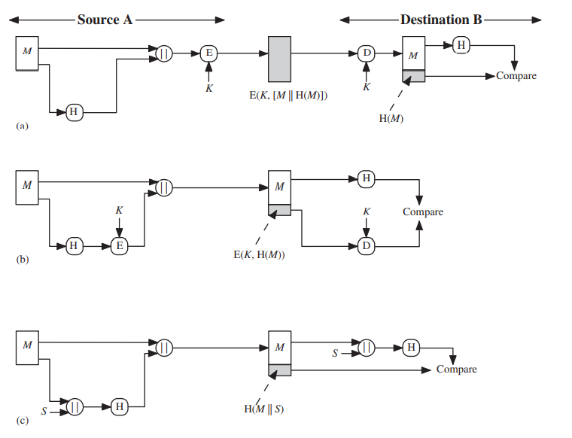
Message Authentication

Slide 30
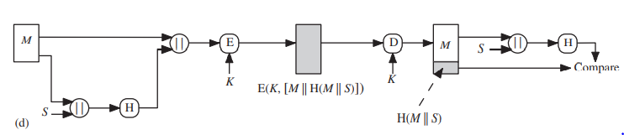
Message Authentication

Slide 31
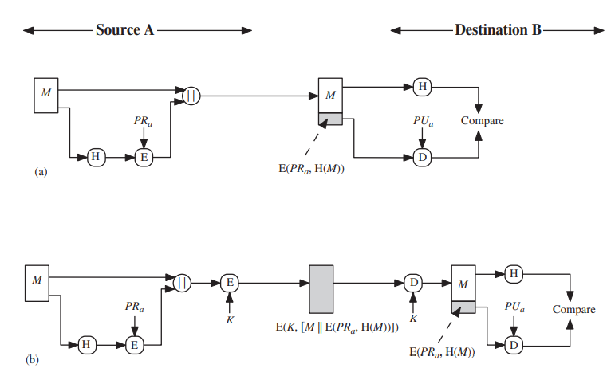
Digital Signatures

Slide 32
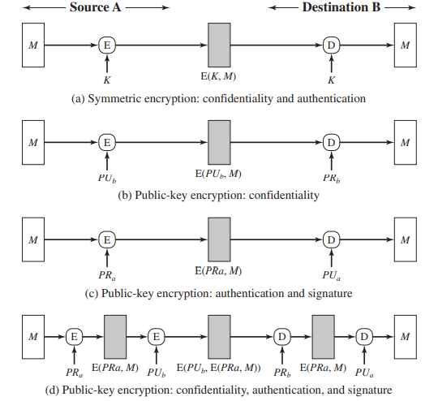
Message Authentication

Slide 33
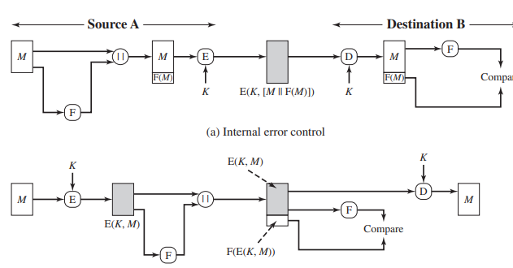
Message Authentication

Slide 34
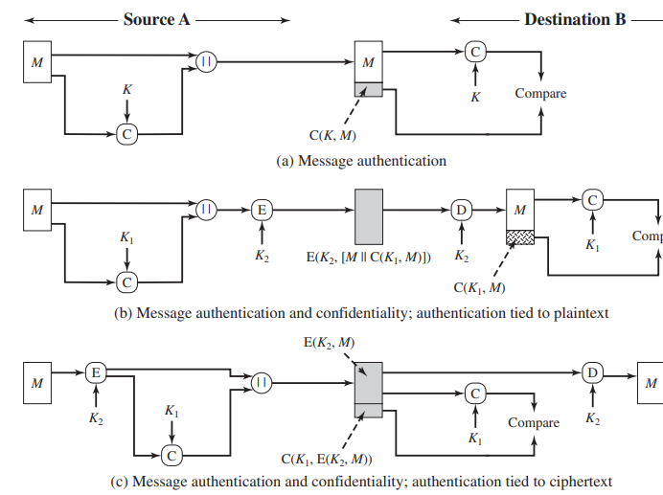
Message Authentication

Slide 35
Keyed Hash Functions as MACs
want a MAC based on a hash function
because hash functions are generally faster
crypto hash function code is widely available
hash includes a key along with message
original proposal:
KeyedHash = Hash(Key|Message)
some weaknesses were found with this
eventually led to development of HMAC
Notes:
In recent years, there has been increased interest in developing a MAC derived from a cryptographic hash function, because they generally execute faster in software than symmetric block ciphers, and because code for cryptographic hash functions is widely available. A hash function such as SHA was not designed for use as a MAC and cannot be used directly for that purpose because it does not rely on a secret key. There have been a number of proposals for the incorporation of a secret key into an existing hash algorithm, originally by just pre-pending a key to the message. Problems were found with these earlier, simpler proposals, but they resulted in the development of HMAC.

Slide 36
HMAC Design Objectives
use, without modifications, hash functions
allow for easy replaceability of embedded hash function
preserve original performance of hash function without significant degradation
use and handle keys in a simple way.
have well understood cryptographic analysis of authentication mechanism strength
Notes:
RFC 2104 lists the following design objectives for HMAC:
• To use, without modifications, available hash functions. In particular, hash functions that perform well in software, and for which code is freely and widely available.
• To allow for easy replaceability of the embedded hash function in case faster or more secure hash functions are found or required.
• To preserve the original performance of the hash function without incurring a significant degradation.
• To use and handle keys in a simple way.
• To have a well understood cryptographic analysis of the strength of the authentication mechanism based on reasonable assumptions about the embedded hash function.

Slide 37
HMAC
specified as Internet standard RFC2104
uses hash function on the message:
HMAC_{K}(M)= Hash[(K⁺ XOR opad) ||
Hash[(K⁺ XOR ipad) || M)] ]
where K⁺ is the key padded out to size
opad, ipad are specified padding constants
overhead is just 3 more hash calculations than the message needs alone
any hash function can be used
eg. MD5, SHA-1, RIPEMD-160, Whirlpool
Notes:
The idea of a keyed hash evolved into HMAC, designed to overcome some problems with the original proposals. It involves hashing padded versions of the key concatenated with the message, and then with another outer hash of the result prepended by another padded variant of the key. The hash function need only be used on 3 more blocks than when hashing just the original message (for the two keys + inner hash). HMAC can use any desired hash function, and has been shown to have the same security as the underlying hash function. Can choose the hash function to use based on speed/security concerns.

Slide 38
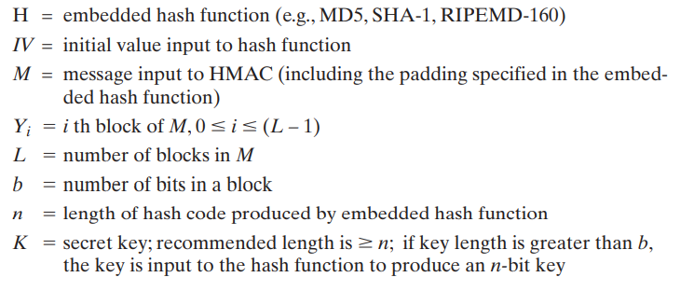
HMAC Algorithm
Notes:
The idea of a keyed hash evolved into HMAC, designed to overcome some problems with the original proposals. It involves hashing padded versions of the key concatenated with the message, and then with another outer hash of the result prepended by another padded variant of the key. The hash function need only be used on 3 more blocks than when hashing just the original message (for the two keys + inner hash). HMAC can use any desired hash function, and has been shown to have the same security as the underlying hash function. Can choose the hash function to use based on speed/security concerns.

Slide 39
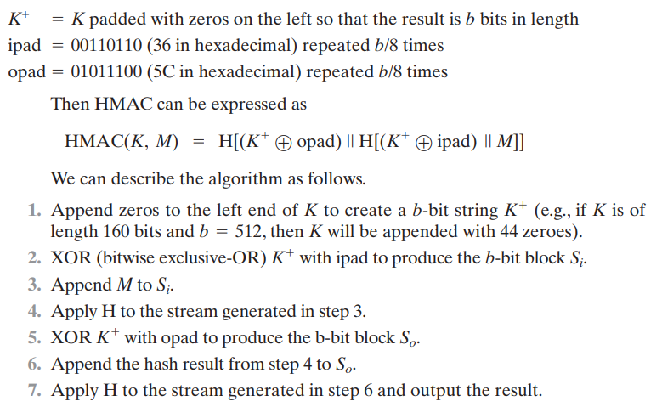
HMAC Algorithm
Notes:
The idea of a keyed hash evolved into HMAC, designed to overcome some problems with the original proposals. It involves hashing padded versions of the key concatenated with the message, and then with another outer hash of the result prepended by another padded variant of the key. The hash function need only be used on 3 more blocks than when hashing just the original message (for the two keys + inner hash). HMAC can use any desired hash function, and has been shown to have the same security as the underlying hash function. Can choose the hash function to use based on speed/security concerns.

Slide 40
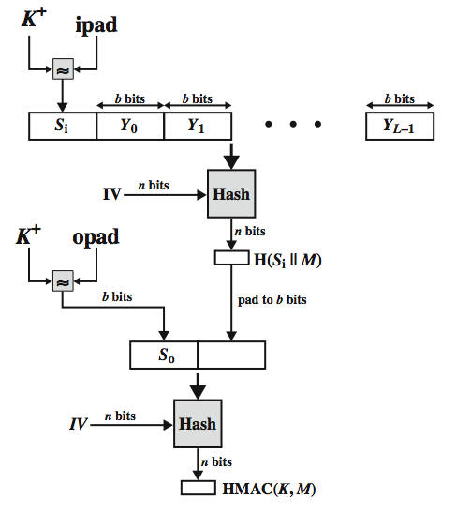
HMAC Overview f(IV,(K+ XOR iPad))
Notes:
Stallings Figure 12.5 illustrates the overall operation of HMAC:
HMAC_{K} = Hash[(K⁺ XOR opad) || Hash[(K⁺ XOR ipad) || M)]
where:
K⁺ is K padded with zeros on the left so that the result is b bits in length
ipad is a pad value of 36 hex repeated to fill block
opad is a pad value of 5C hex repeated to fill block
M is the message input to HMAC (including the padding specified in the embedded hash function)
Note that the XOR with ipad results in flipping one-half of the bits of K. Similarly, the XOR with opad results in flipping one-half of the bits of K, but a different set of bits. In effect, pseudorandomly generated two keys from K. HMAC should execute in approximately the same time as the embedded hash function for long messages. HMAC adds three executions of the hash compression function (for Si, So, and the block produced from the inner hash). A more efficient implementation is possible by precomputing the internal hash function on (K⁺ XOR opad) and (K⁺ XOR ipad) and inserting the results into the hash processing at start & end. With this implementation, only one additional instance of the compression function is added to the processing normally produced by the hash function. This is especially worthwhile if most of the messages for which a MAC is computed are short.

Slide 41
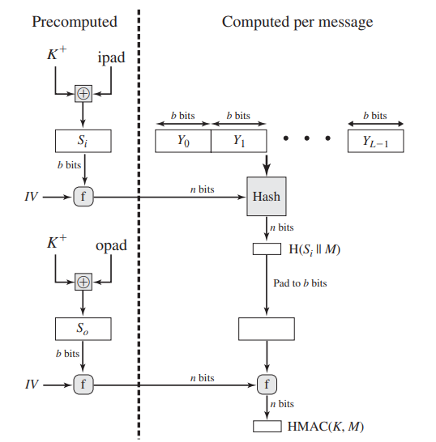
Efficient Implementation of HMAC f(IV,(K+ XOR OPad))
Notes:
Stallings Figure 12.5 illustrates the overall operation of HMAC:
HMAC_{K} = Hash[(K⁺ XOR opad) || Hash[(K⁺ XOR ipad) || M)]
where:
K⁺ is K padded with zeros on the left so that the result is b bits in length
ipad is a pad value of 36 hex repeated to fill block
opad is a pad value of 5C hex repeated to fill block
M is the message input to HMAC (including the padding specified in the embedded hash function)
Note that the XOR with ipad results in flipping one-half of the bits of K. Similarly, the XOR with opad results in flipping one-half of the bits of K, but a different set of bits. In effect, pseudorandomly generated two keys from K. HMAC should execute in approximately the same time as the embedded hash function for long messages. HMAC adds three executions of the hash compression function (for Si, So, and the block produced from the inner hash). A more efficient implementation is possible by precomputing the internal hash function on (K⁺ XOR opad) and (K⁺ XOR ipad) and inserting the results into the hash processing at start & end. With this implementation, only one additional instance of the compression function is added to the processing normally produced by the hash function. This is especially worthwhile if most of the messages for which a MAC is computed are short.

Slide 42
HMAC Security
proved security of HMAC relates to that of the underlying hash algorithm
attacking HMAC requires either:
brute force attack on key used
birthday attack (but since keyed would need to observe a very large number of messages)
choose hash function used based on speed verses security constraints
Notes:
The appeal of HMAC is that its designers have been able to prove an exact relationship between the strength of the embedded hash function and the strength of HMAC. The security of a MAC function is generally expressed in terms of the probability of successful forgery with a given amount of time spent by the forger and a given number of message-MAC pairs created with the same key. Have two classes of attacks: brute force attack on key used which has work of order 2^n; or a birthday attack which requires work of order 2^(n/2) - but which requires the attacker to observe 2^n blocks of messages using the same key - very unlikely. For a hash code length of 128 bits, this requires 2⁶⁴ observed blocks (2⁷² bits) generated using the same key. On a 1-Gbps link, one would need to observe a continuous stream of messages with no change in key for about 150,000 years in order to succeed. So even MD5 is still secure for use in HMAC given these constraints.

Slide 43
MACs based on Block Ciphers: DAA & CMAC
Notes:
The idea of a keyed hash evolved into HMAC, designed to overcome some problems with the original proposals. It involves hashing padded versions of the key concatenated with the message, and then with another outer hash of the result prepended by another padded variant of the key. The hash function need only be used on 3 more blocks than when hashing just the original message (for the two keys + inner hash). HMAC can use any desired hash function, and has been shown to have the same security as the underlying hash function. Can choose the hash function to use based on speed/security concerns.

Slide 44
Using Symmetric Ciphers for MACs
can use any block cipher chaining mode and use final block as a MAC
Data Authentication Algorithm (DAA) is a widely used MAC based on DES-CBC
using IV=0 and zero-pad of final block
encrypt message using DES in CBC mode
and send just the final block as the MAC
or the leftmost M bits (16≤M≤64) of final block
but final MAC is now too small for security
Notes:
In this section, we look at two MACs that are based on the use of a block cipher mode of operation. We begin with an older algorithm, the Data Authentication Algorithm (DAA), a widely used though now obsolete MAC based on DES-CBC (next slide). However this suffers from being too small for acceptable use today.

Slide 45
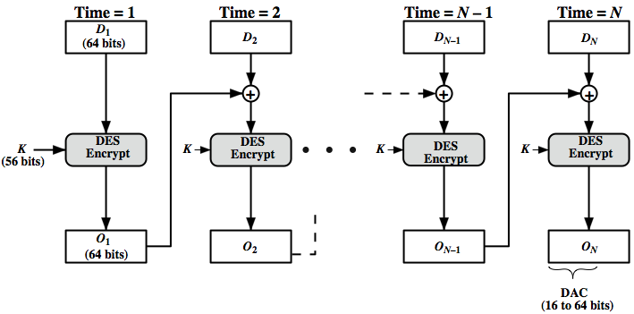
Data Authentication Algorithm
Notes:
The Data Authentication Algorithm, based on DES, has been one of the most widely used MACs for a number of years. The algorithm is both a FIPS publication (FIPS PUB 113) and an ANSI standard (X9.17). However, security weaknesses in this algorithm have been discovered and it is being replaced by newer and stronger algorithms. The algorithm is shown here in Stallings Figure 12.7, and can be defined as using the cipher block chaining (CBC) mode of operation of DES, with an initialization vector of zero, and 0-pad of the final block if needed. Resulting MAC can be 16-64 bits of the final block. But this is now too small for security.

Slide 46
CMAC
previously saw the DAA (CBC-MAC)
widely used in govt & industry
but has message size limitation
can overcome using 2 keys & padding
thus forming the Cipher-based Message Authentication Code (CMAC)
adopted by NIST SP800-38B
Notes:
The Data Authentication Algorithm cipher-based MAC has been widely adopted in government and industry. Has been shown to be secure, with the following restriction. Only messages of one fixed length of mn bits are processed, where n is the cipher block size and m is a fixed positive integer. This limitation can be overcome using multiple keys, which can be derived from a single key. This refinement has been adopted by NIST as the cipher-based message authentication code (CMAC) mode of operation, for use with AES and triple DES. It is specified in NIST Special Publication 800-38B.

Slide 47
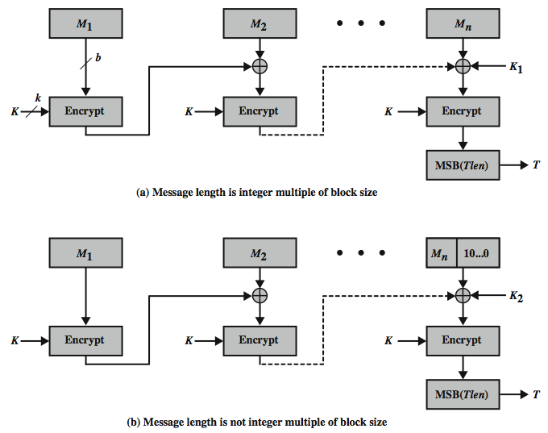
CMAC Overview
Notes:
Stallings Figure 12.8 shows the structure of CMAC. It uses the blocksize of the underlying cipher (ie 128-bits for AES or 64-bits for triple-DES). The message is divided into n blocks M1..Mn, padded if necessary. The algorithm makes use of a k-bit encryption key K and an n-bit constant K1 or K2 (depending on whether the message was padded or not). For AES, the key size k is 128,192, or 256 bits; for triple DES, the key size is 112 or 168 bits. The two constants K1 & K2 are derived from the original key K using encryption of 0 and multiplication in GF(2^n), as detailed in the text.

Slide 48
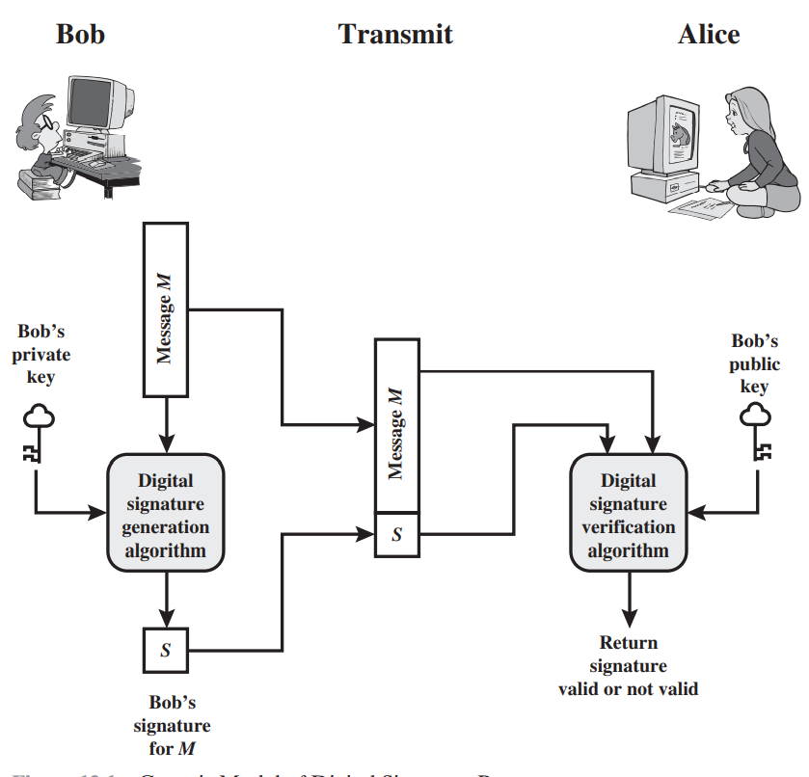
Generic Model of Digital Signature Process
Notes:
Stallings Figure 12.8 shows the structure of CMAC. It uses the blocksize of the underlying cipher (ie 128-bits for AES or 64-bits for triple-DES). The message is divided into n blocks M1..Mn, padded if necessary. The algorithm makes use of a k-bit encryption key K and an n-bit constant K1 or K2 (depending on whether the message was padded or not). For AES, the key size k is 128,192, or 256 bits; for triple DES, the key size is 112 or 168 bits. The two constants K1 & K2 are derived from the original key K using encryption of 0 and multiplication in GF(2^n), as detailed in the text.

Slide 49
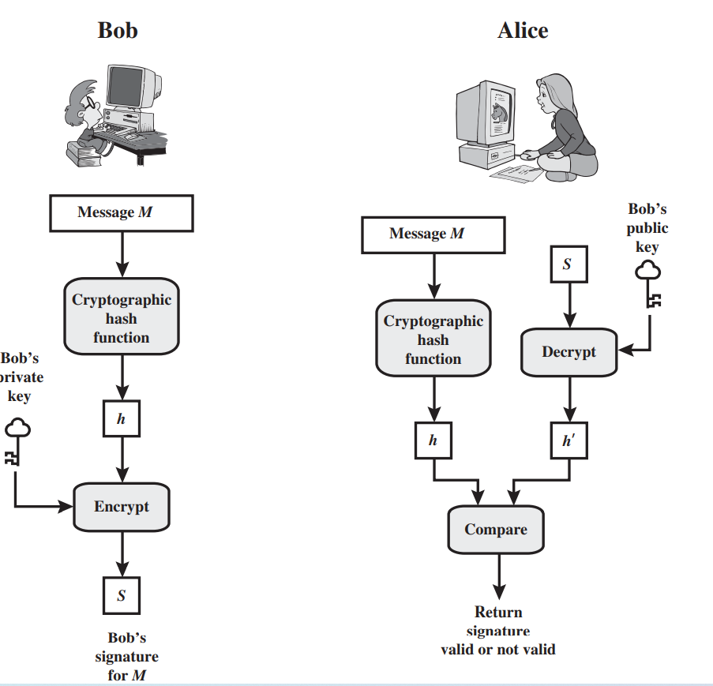
CMAC Overview
Notes:
Stallings Figure 12.8 shows the structure of CMAC. It uses the blocksize of the underlying cipher (ie 128-bits for AES or 64-bits for triple-DES). The message is divided into n blocks M1..Mn, padded if necessary. The algorithm makes use of a k-bit encryption key K and an n-bit constant K1 or K2 (depending on whether the message was padded or not). For AES, the key size k is 128,192, or 256 bits; for triple DES, the key size is 112 or 168 bits. The two constants K1 & K2 are derived from the original key K using encryption of 0 and multiplication in GF(2^n), as detailed in the text.

Slide 50
Digital Signature Properties
It must verify the author and the date and time of the signature
It must authenticate the contents at the time of the signature
It must be verifiable by third parties, to resolve disputes
Notes:
Message authentication protects two parties who exchange messages from any third
party. However, it does not protect the two parties against each other. Several forms
of dispute between the two are possible.
In situations where there is not complete trust between sender and receiver,
something more than authentication is needed. The most attractive solution to
this problem is the digital signature. The digital signature must have the following
properties:
• It must verify the author and the date and time of the signature.
• It must authenticate the contents at the time of the signature.
• It must be verifiable by third parties, to resolve disputes.
Thus, the digital signature function includes the authentication function.

Slide 51
Attacks
Key-only attack
C only knows A’s public key
Known message attack
C is given access to a set of messages and their signatures
Generic chosen message attack
C chooses a list of messages before attempting to break A’s signature scheme, independent of A’s public key; C then obtains from A valid signatures for the chosen messages
Directed chosen message attack
Similar to the generic attack, except that the list of messages to be signed is chosen after C knows A’s public key but before any signatures are seen
Adaptive chosen message attack
C may request from A signatures of messages that depend on previously obtained message-signature pairs
Notes:
[GOLD88] lists the following types of attacks, in order of increasing severity. Here
A denotes the user whose signature method is being attacked, and C denotes the
attacker.
• Key-only attack: C only knows A’s public key.
• Known message attack: C is given access to a set of messages and their
signatures.
• Generic chosen message attack: C chooses a list of messages before attempting
to breaks A’s signature scheme, independent of A’s public key. C then
obtains from A valid signatures for the chosen messages. The attack is generic,
because it does not depend on A’s public key; the same attack is used against
everyone.
• Directed chosen message attack: Similar to the generic attack, except that the
list of messages to be signed is chosen after C knows A’s public key but before
any signatures are seen.
• Adaptive chosen message attack: C is allowed to use A as an “oracle.” This
means that C may request from A signatures of messages that depend on previously
obtained message-signature pairs.

Slide 52
Forgeries
Total break
C determines A’s private key
Universal forgery
C finds an efficient signing algorithm that provides an equivalent way of constructing signatures on arbitrary messages
Selective forgery
C forges a signature for a particular message chosen by C
Existential forgery
C forges a signature for at least one message; C has no control over the message
Notes:
[GOLD88] then defines success at breaking a signature scheme as an outcome
in which C can do any of the following with a non-negligible probability:
• Total break: C determines A’s private key.
• Universal forgery: C finds an efficient signing algorithm that provides an
equivalent way of constructing signatures on arbitrary messages.
• Selective forgery: C forges a signature for a particular message chosen by C.
• Existential forgery: C forges a signature for at least one message. C has no
control over the message. Consequently, this forgery may only be a minor nuisance
to A.

Slide 53
Digital Signature Requirements
The signature must be a bit pattern that depends on the message being signed
The signature must use some information unique to the sender to prevent both forgery and denial
It must be relatively easy to produce the digital signature
It must be relatively easy to recognize and verify the digital signature
It must be computationally infeasible to forge a digital signature, either by constructing a new message for an existing digital signature or by constructing a fraudulent digital signature for a given message
It must be practical to retain a copy of the digital signature in storage
Notes:
On the basis of the properties and attacks just discussed, we can formulate the following
requirements for a digital signature.
• The signature must be a bit pattern that depends on the message being signed.
• The signature must use some information unique to the sender to prevent
both forgery and denial.
• It must be relatively easy to produce the digital signature.
• It must be relatively easy to recognize and verify the digital signature.
• It must be computationally infeasible to forge a digital signature, either by
constructing a new message for an existing digital signature or by constructing
a fraudulent digital signature for a given message.
• It must be practical to retain a copy of the digital signature in storage.
A secure hash function, embedded in a scheme such as that of Figure 13.2, provides
a basis for satisfying these requirements. However, care must be taken in the design
of the details of the scheme.

Slide 54
Direct Digital Signature
Refers to a digital signature scheme that involves only the communicating parties
It is assumed that the destination knows the public key of the source
Confidentiality can be provided by encrypting the entire message plus signature with a shared secret key
It is important to perform the signature function first and then an outer confidentiality function
In case of dispute some third party must view the message and its signature
The validity of the scheme depends on the security of the sender’s private key
If a sender later wishes to deny sending a particular message, the sender can claim that the private key was lost or stolen and that someone else forged his or her signature
One way to thwart or at least weaken this ploy is to require every signed message to include a timestamp and to require prompt reporting of compromised keys to a central authority
Notes:
The term direct digital signature refers to a digital signature scheme that involves
only the communicating parties (source, destination). It is assumed that the destination
knows the public key of the source.
Confidentiality can be provided by encrypting the entire message plus signature
with a shared secret key (symmetric encryption). Note that it is important to
perform the signature function first and then an outer confidentiality function. In
case of dispute, some third party must view the message and its signature. If the signature
is calculated on an encrypted message, then the third party also needs access
to the decryption key to read the original message. However, if the signature is the
inner operation, then the recipient can store the plaintext message and its signature
for later use in dispute resolution.
The validity of the scheme just described depends on the security of the sender’s
private key. If a sender later wishes to deny sending a particular message, the sender
can claim that the private key was lost or stolen and that someone else forged his or her
signature. Administrative controls relating to the security of private keys can be employed
to thwart or at least weaken this ploy, but the threat is still there, at least to some
degree. One example is to require every signed message to include a timestamp (date
and time) and to require prompt reporting of compromised keys to a central authority.
Another threat is that some private key might actually be stolen from X
at time T. The opponent can then send a message signed with X’s signature and
stamped with a time before or equal to T.
The universally accepted technique for dealing with these threats is the use
of a digital certificate and certificate authorities. We defer a discussion of this topic
until Chapter 14, and focus in this chapter on digital signature algorithms.

Slide 55
NIST Digital Signature Algorithm
Published by NIST as Federal Information Processing Standard FIPS 186
Makes use of the Secure Hash Algorithm (SHA)
The latest version, FIPS 186-3, also incorporates digital signature algorithms based on RSA and on elliptic curve cryptography
Notes:
The National Institute of Standards and Technology (NIST) has published
Federal Information Processing Standard FIPS 186, known as the Digital
Signature Algorithm (DSA). The DSA makes use of the Secure Hash
Algorithm (SHA) described in Chapter 12. The DSA was originally proposed
in 1991 and revised in 1993 in response to public feedback concerning the security
of the scheme. There was a further minor revision in 1996. In 2000, an
expanded version of the standard was issued as FIPS 186-2, subsequently updated
to FIPS 186-3 in 2009. This latest version also incorporates digital signature
algorithms based on RSA and on elliptic curve cryptography. In this
section, we discuss DSA.

Slide 56
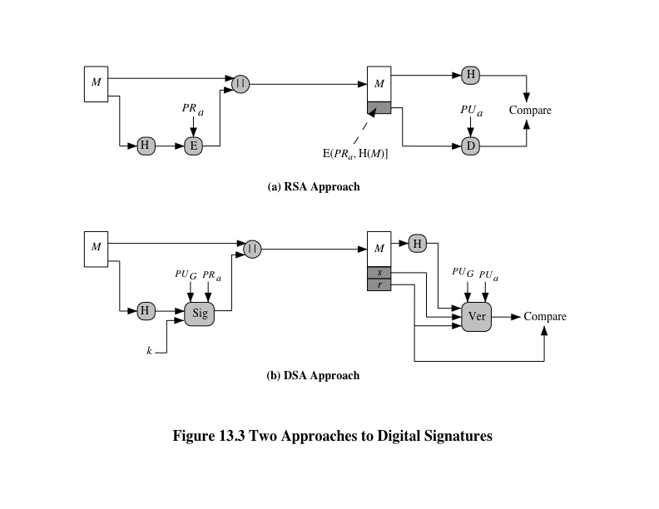
Notes:
The DSA uses an algorithm that is designed to provide only the digital signature
function. Unlike RSA, it cannot be used for encryption or key exchange.
Nevertheless, it is a public-key technique.
Figure 13.3 contrasts the DSA approach for generating digital signatures to
that used with RSA. In the RSA approach, the message to be signed is input to a
hash function that produces a secure hash code of fixed length. This hash code is
then encrypted using the sender’s private key to form the signature. Both the message
and the signature are then transmitted. The recipient takes the message and
produces a hash code. The recipient also decrypts the signature using the sender’s
public key. If the calculated hash code matches the decrypted signature, the signature
is accepted as valid. Because only the sender knows the private key, only the
sender could have produced a valid signature.
The DSA approach also makes use of a hash function. The hash code is provided
as input to a signature function along with a random number k generated
for this particular signature. The signature function also depends on the sender’s
private key (PR_{a} ) and a set of parameters known to a group of communicating principals.
We can consider this set to constitute a global public key (PU_{G} ). The result
is a signature consisting of two components, labeled s and r .
At the receiving end, the hash code of the incoming message is generated. This
plus the signature is input to a verification function. The verification function also
depends on the global public key as well as the sender’s public key (PU_{a} ), which
is paired with the sender’s private key. The output of the verification function is a
value that is equal to the signature component r if the signature is valid. The signature
function is such that only the sender, with knowledge of the private key, could
have produced the valid signature.

Slide 57
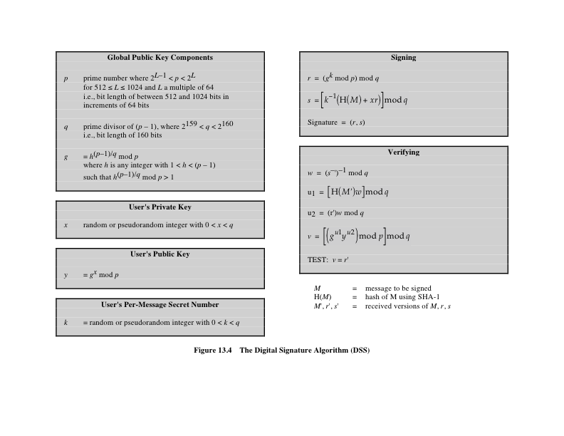
Notes:
The DSA is based on the difficulty of computing discrete logarithms (see Chapter 8)
and is based on schemes originally presented by Elgamal [ELGA85] and Schnorr
[SCHN91].
Figure 13.4 summarizes the algorithm.

Slide 58
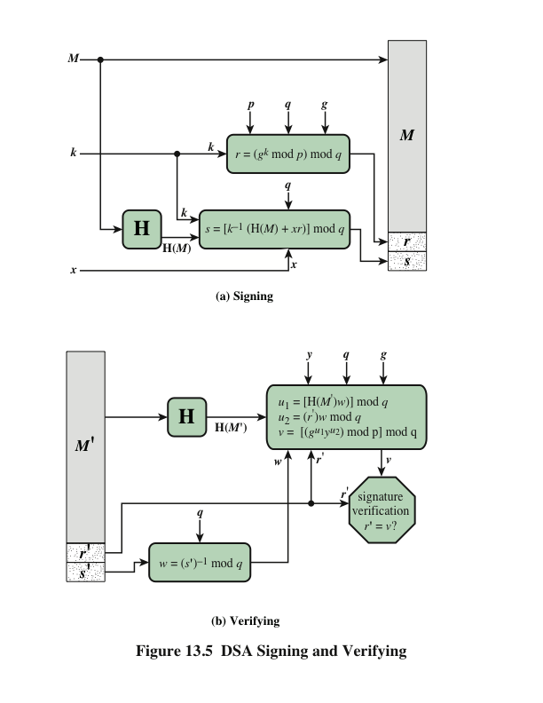
DSA Signing and Verifying
Notes:
Figure 13.5 depicts the functions of signing and verifying.
The structure of the algorithm, as revealed in Figure 13.5, is quite interesting.
Note that the test at the end is on the value r , which does not depend on the message
at all. Instead, r is a function of k and the three global public-key components. The
multiplicative inverse of k (mod q ) is passed to a function that also has as inputs
the message hash code and the user’s private key. The structure of this function is
such that the receiver can recover r using the incoming message and signature, the
public key of the user, and the global public key. It is certainly not obvious from
Figure 13.4 or Figure 13.5 that such a scheme would work. A proof is provided in
Appendix K.

Slide 59


Slide 60
The End

